Slide 1
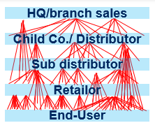
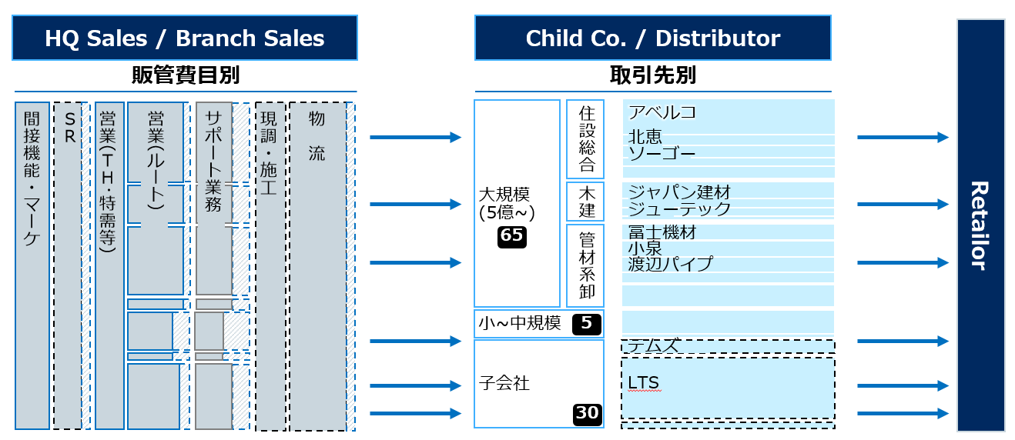
Largest housing material manufacturer – optimized sales channel network and account allocation based on virtual PL by accounts
Basic Materials (GEM) | Asia-Pacific
BAS017
Situation
What we did
Impact
Largest housing material equipment supplier in Japan
We analyzed the whole accounts data and developed sales channel network map
OP+: Published mid-term management plan and executing restructuring of channel network to improve OP $ 100~ mln
After rapid in organic growth, B2B sales channel network became so complicated…
To design efficient channel network(e.g. accounts to go or delegate to distributor / areas to promote integration), we calculated each accounts’ virtual PL by bridging sales database & daily report data base, then found a lot of OP minus accounts
Corporate culture change: from Sales/Gross profit based account planning to Operation profit based accounts PDCA
President of the group ordered its optimization but no one grasped overall picture
PL by
account
Sales DB
Daily Report DB
Designed integration plan and account allocation

